Slide 1
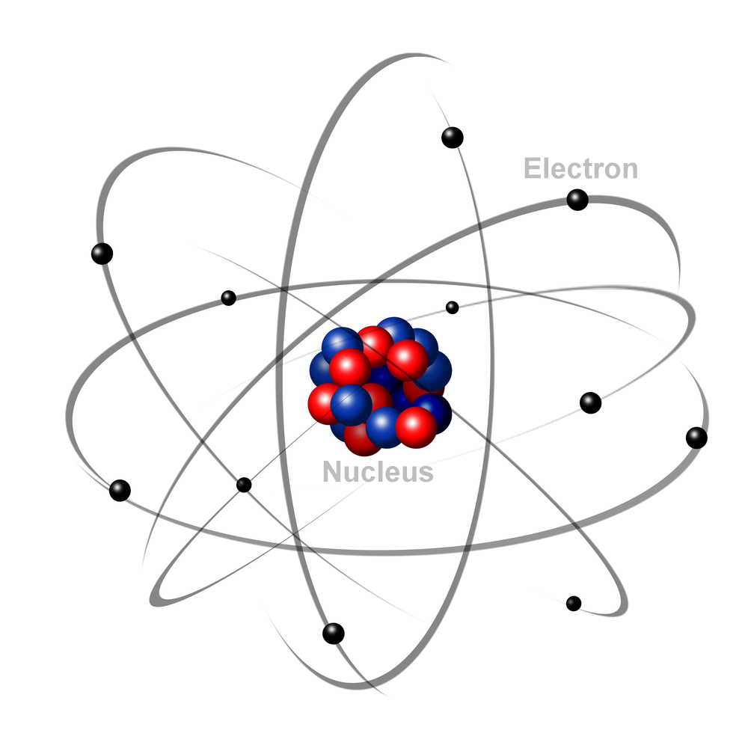
Multi-electron systems with DFT – optimizing, choosing basis sets, XC functional
June 13, 2022

Slide 2
Goals for this session
Review H₂⁺ optimization to go over general structure of a computational quantum mechanics calculation
Be able to recognize the steps a molecule optimization code takes
Be able to describe the general types of basis sets, and be able to make general choices and check dependence of results on basis set
Be able to describe the types of exchange-correlation functionals and their rough hierarchical accuracy

Slide 3
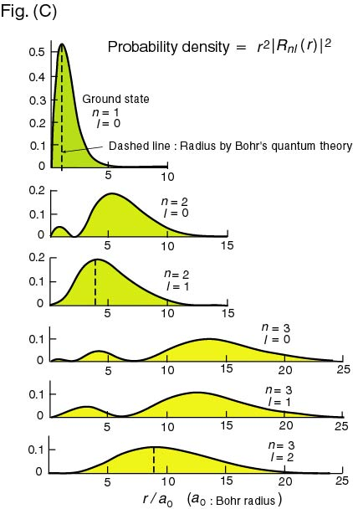
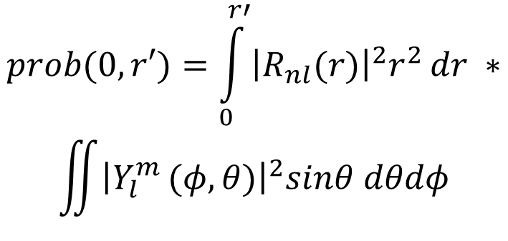
The Hydrogen Atom – Radial Distribution Functions
Probability of finding the electron a given distance from the nuclei
$$prob(0,r′)=\int_{0}^{r′}{{\left|R_{nl}(r)\right|}^{2}r^{2}}dr ∗$$
$$\iint{{\left|Y_{l}^{m }(φ,θ)\right|}^{2}sinθ dθdφ}$$

Slide 4
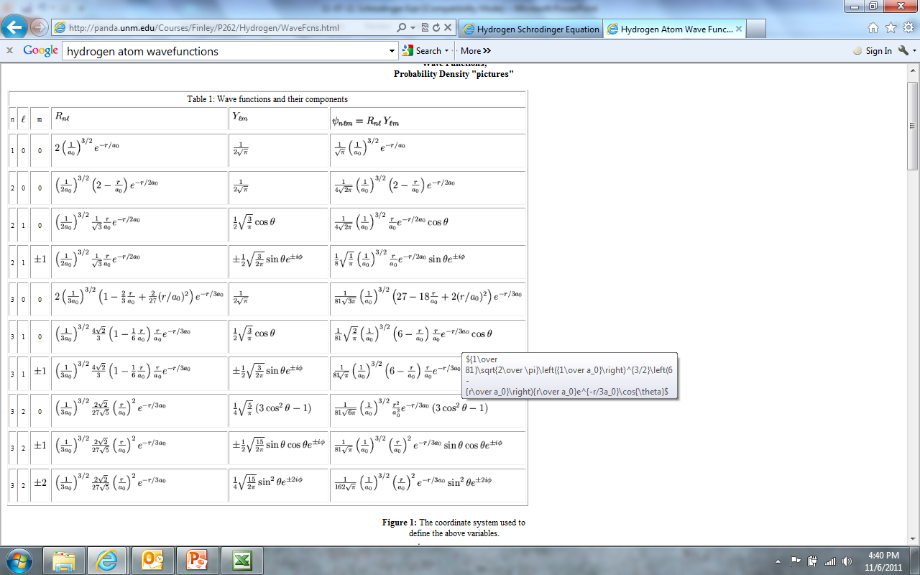
The Hydrogen Atom – Total Wavefunctions

Slide 5

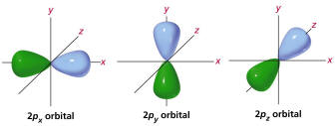
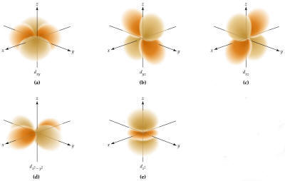
The Hydrogen Atom – Total Wavefunctions
s (n=1, 2, ..; l=0, m=0)
p (n=2, 3, …; l=1, m=-1,0,1)
d (n=3,4,…;l=2, m=-2, -1, 0, 1, 2)

Slide 6
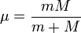
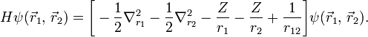
More than 1 electron: He atom Schrodinger Equation
KE electron e – nucleus KE nucleus electron-electron
Distance vectors between electron and nucleus)
Heavy atoms: Born-Oppenheimer approximation, removes KE nucleus term. In atomic units (ie, non-dimensionalized by constants):
Wavefunction now a function of x₁, y₁, z₁, x₂, y₂, z₂ (or r₁, θ₁, φ₁, r₂, θ₂, φ₂). Because of electron-electron term, this is not separable in any coordinate system. Must be solved by approximate methods.

Slide 7
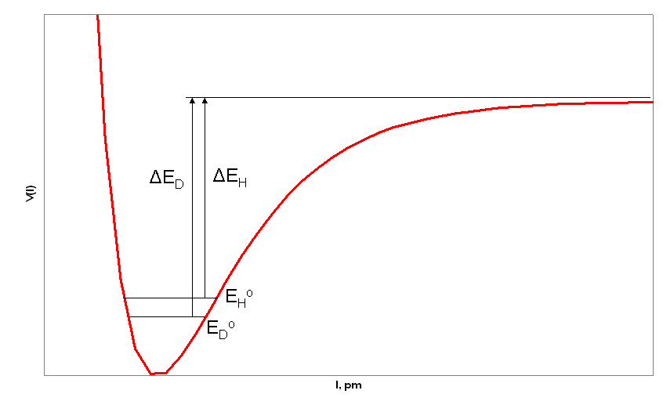
General first step: ab initio geometry optimization
Energy
Diatomic molecule distance

Slide 8
General scheme of an ab initio geometry optimization calculation
Born Oppenheimer approximation – nuclei heavier and slower than electrons, so we can think of nuclei as static “atom position”, electrons adjust, and potential energy surface is the energy of the system as a function of nuclei positions, with electrons in “optimal” configuration at each set of nuclei position
Build structure – guess of nuclei positions (ie, where are the nuclei)
Do a QM calculation to get the energy
Calculate the forces on atoms (dE / d (atom positions)
Check forces – close enough to 0? Yes – done
No –
Optimizer algorithm generates
next step for atom positions
Energy
Diatomic molecule distance (R)

Slide 9
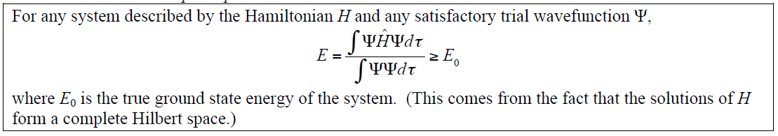
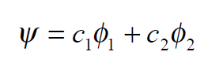
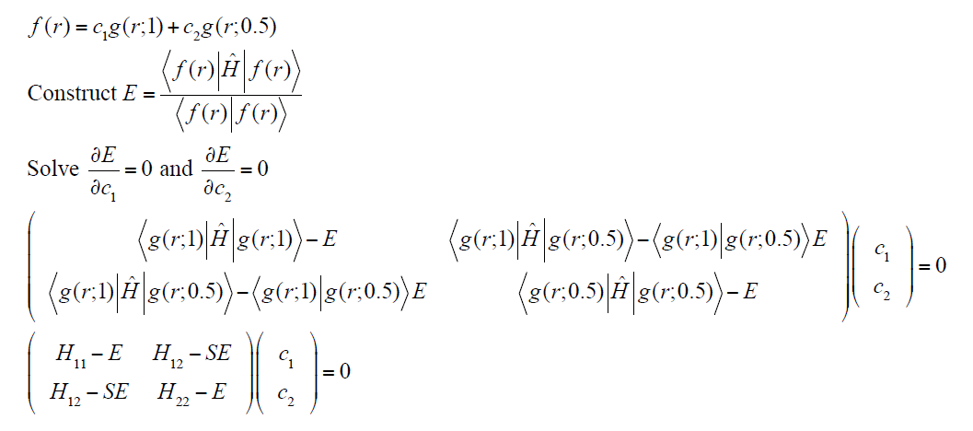
Variational Theorem gives us an approach to get “best” wavefunctions
See https://adambaskerville.github.io/posts/Variational-Method-Hydrogen/
We get the best wave function given a presumed form of the solution…….
We can guess that the wavefunction will have some form:
For H₂⁺ - let’s use that the molecular wavefunction is a sum of 1s orbitals on each atom
If we have Hamiltonian and we have this functional form, problem is minimizing E with respect to c_{i}’s

Slide 10
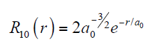
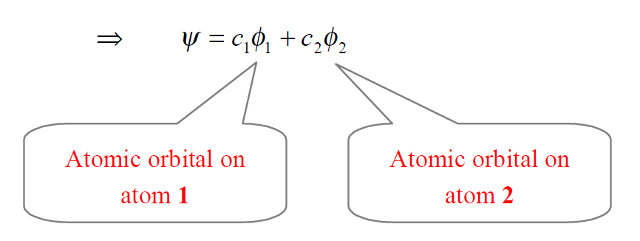
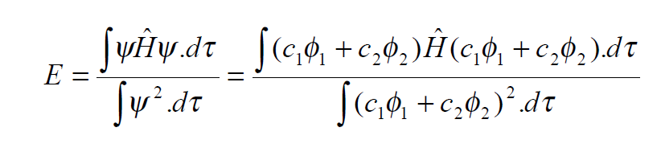
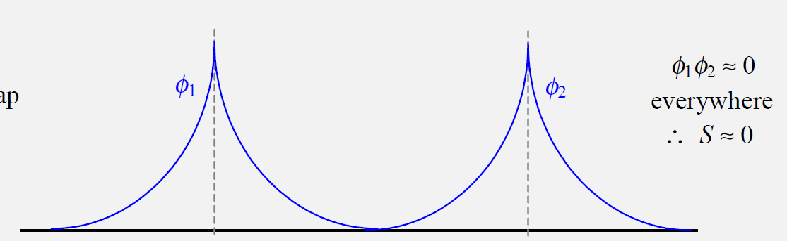
H₂+ Molecule Example – we need to find “best” c’s given our assumed ψ function
H 1s
Nuclei 1
Nuclei 2
R

Slide 11
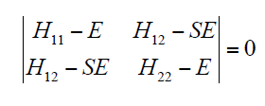
The H₂⁺ system will be analytically solvable in a single “step” due to no e⁻-e⁻ interaction
Yields Quadratic Function of E
Both E’s are solutions → 1s and 2s orbital energies
Solve for c_{i}(E1) and c_{i}(E2) →
For E1 → c₁ = c₂
For E2 → c₁ = -c₂

Slide 12
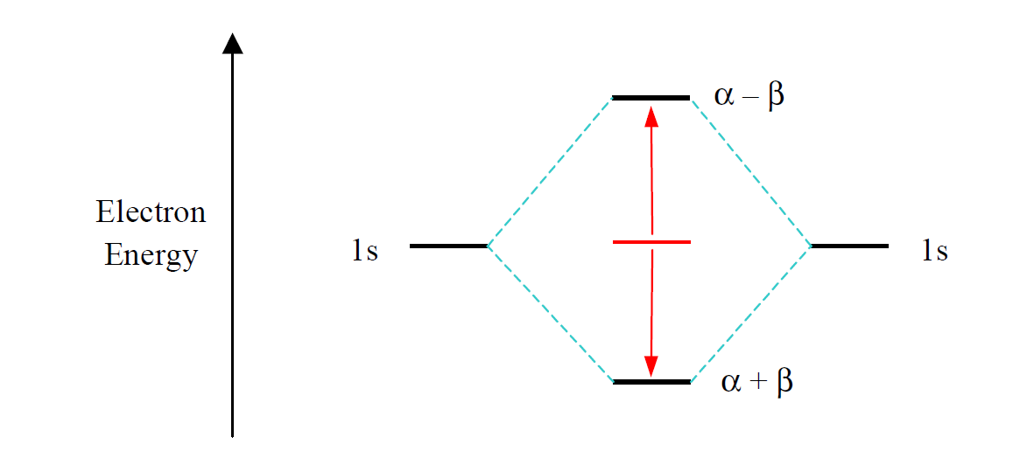
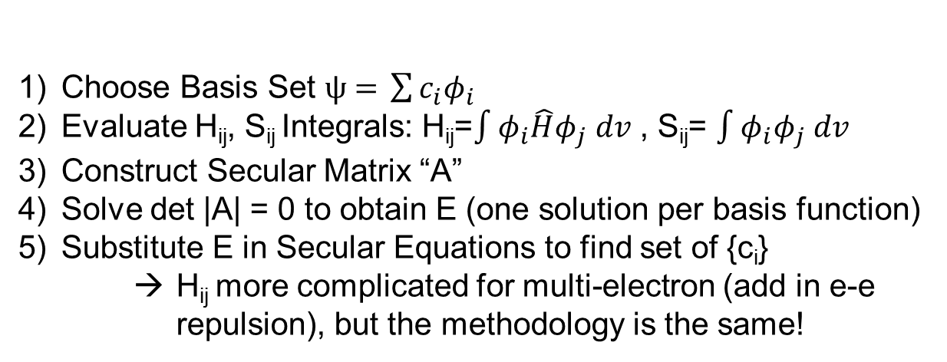
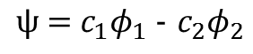
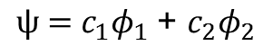
We can make an orbital energy level diagram
$$ψ\text{ = }c_{1}φ_{1} \text{−} c_{2}φ_{2}$$
$$ψ\text{ = }c_{1}φ_{1} \text{+ }c_{2}φ_{2}$$
Choose Basis Set $ψ\text{ =} \sum{{c_{i}φ}_{i}}$
Evaluate H_{ij}, S_{ij} Integrals: H_{ij}=$\int{φ_{i}\hat{H}φ_{j} dv}$ , S_{ij}= $\int{φ_{i}φ_{j} dv}$
Construct Secular Matrix “A”
Solve det |A| = 0 to obtain E (one solution per basis function)
Substitute E in Secular Equations to find set of {c_{i}}
H_{ij} more complicated for multi-electron (add in e-e repulsion), but the methodology is the same!

Slide 13
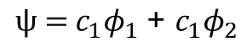
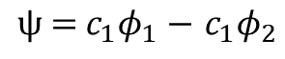
H₂+ molecule example – we have the solutions – what do they look like?
$$ψ\text{ = }c_{1}φ_{1} \text{−} c_{1}φ_{2}$$
R
$$ψ\text{ = }c_{1}φ_{1} \text{+ }c_{1}φ_{2 }$$
What does the electron density versus distance apart look like?
What does the anti-bonding wavefunction look like, and what would it’s density look like?
How will this change as R is varied?

Slide 14
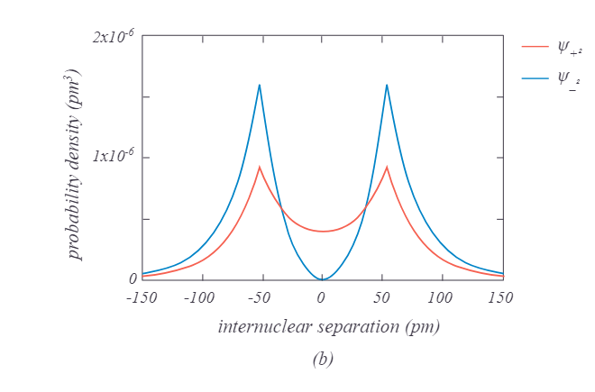
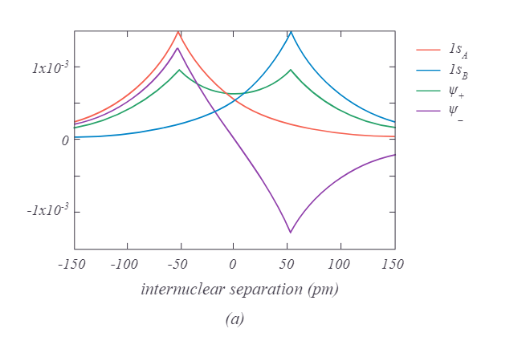
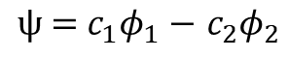
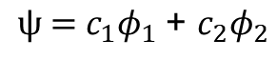
Bonding orbital has constructive overlap between nuclei, antibonding has a node
$$ψ\text{ = }c_{1}φ_{1} \text{+ }c_{2}φ_{2}$$
$$ψ\text{ = }c_{1}φ_{1} \text{−} c_{2}φ_{2}$$

Slide 15
Review the steps we took:
Choose Basis Set $ψ\text{ =} \sum{{c_{i}φ}_{i}}$
Evaluate H_{ij}, S_{ij} Integrals: H_{ij}=$\int{φ_{i}\hat{H}φ_{j} dv}$ , S_{ij}= $\int{φ_{i}φ_{j} dv}$
Construct Secular Matrix “A”
Solve det |A| = 0 to obtain E (one solution per basis function)
Substitute E in Secular Equations to find set of {c_{i}}
H_{ij} more complicated for multi-electron (add in e-e repulsion), but the methodology is the same!

Slide 16
General scheme of an ab initio geometry optimization calculation
Born Oppenheimer approximation – nuclei heavier and slower than electrons, so we can think of nuclei as static “atom position”, electrons adjust, and potential energy surface is the energy of the system as a function of nuclei positions, with electrons in “optimal” configuration at each set of nuclei position
Build structure – guess of nuclei positions (ie, where are the nuclei)
Do a QM calculation to get the energy
Calculate the forces on atoms (dE / d (atom positions)
Check forces – close enough to 0? Yes – done
No –
Optimizer algorithm generates
next step for atom positions
dE/dR at R₁
Energy
E (R₁)
How to get the forces on atoms – Hellmann-Feynman
https://en.wikipedia.org/wiki/Hellmann%E2%80%93Feynman_theorem
Diatomic molecule distance (R)

Slide 17
General scheme of an ab initio geometry optimization calculation
Born Oppenheimer approximation – nuclei heavier and slower than electrons, so we can think of nuclei as static “atom position”, electrons adjust, and potential energy surface is the energy of the system as a function of nuclei positions, with electrons in “optimal” configuration at each set of nuclei position
Build structure – guess of nuclei positions (ie, where are the nuclei)
Do a QM calculation to get the energy
Calculate the forces on atoms (dE / d (atom positions)
Check forces – close enough to 0? Yes – done
No –
Optimizer algorithm generates
next step for atom positions
dE/dR at R₁
Energy
E (R₁)
How to decide where to put atoms next?
-choice of optimizer algorithm. Not inherently different than minimizing any function.
Diatomic molecule distance (R)

Slide 18
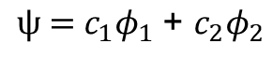
Did we use the “right” functional form for the H₂⁺ wavefunction?
$$ψ\text{ = }c_{1}φ_{1} \text{+ }c_{2}φ_{2}$$
H 1s
-
-
-
-

Slide 19
Did we use the “right” functional form for the H₂⁺ wavefunction?
$$ψ\text{ = }c_{1}φ_{1} \text{+ }c_{2}φ_{2}$$
H 1s
There was no “scientific” requirement we made the H₂⁺ molecular orbital from H 1s functions. If we could use any guess function for ψ, what would tell us we made the “best choice”?
-
-
-
-

Slide 20
Did we use the “right” functional form for the H₂⁺ wavefunction?
$$ψ\text{ = }c_{1}φ_{1} \text{+ }c_{2}φ_{2}$$
H 1s
There was no “scientific” requirement we made the H₂⁺ molecular orbital from H 1s functions. If we could use any guess function for ψ, what would tell us we made the “best choice”?
We could keep changing the guess function, and anything that gave us a lower E would be a better function.
A better function would decay slower between the two nuclei and faster outside then a sum of 1s orbitals……

Slide 21
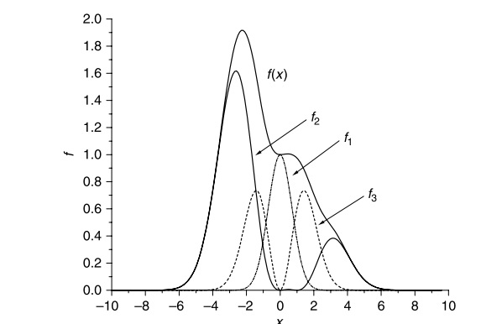
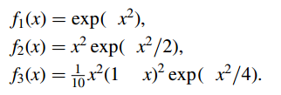
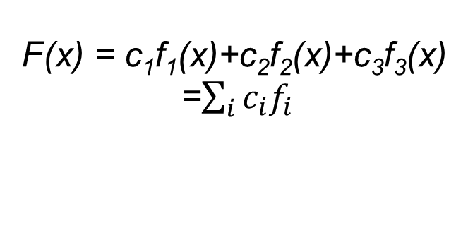
We chose a “basis set” of 1s orbitals on each atom. We can make (many) other choices…….
Linear combination of functions
If “functions” are atom centered orbitals (typically H like s, p, d, f)
“Linear combination of atomic orbitals” - LCAO
F(x) = c₁f₁(x)+c₂f₂(x)+c₃f₃(x)
=$\sum_{i}{c_{i}f_{i}}$
-
-
-
-

Slide 22
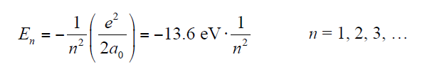
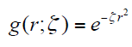
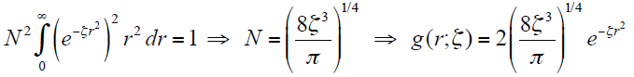
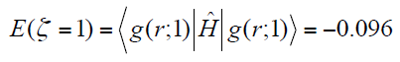
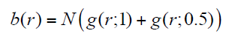
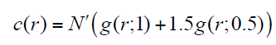
Hydrogen atomic orbitals are computationally inefficient – “hydrogen-like Gaussians” are common choice
Gaussian Trial Function:
Normalize:
Evaluate Energy:
-2.61 eV
Two Gaussians, Equal Weight Trial Function:
E[b(r)] = -8.33 eV
Two Gaussians, Unequal Weight Trial Function:
E[c(r)] = -9.061 eV

Slide 23
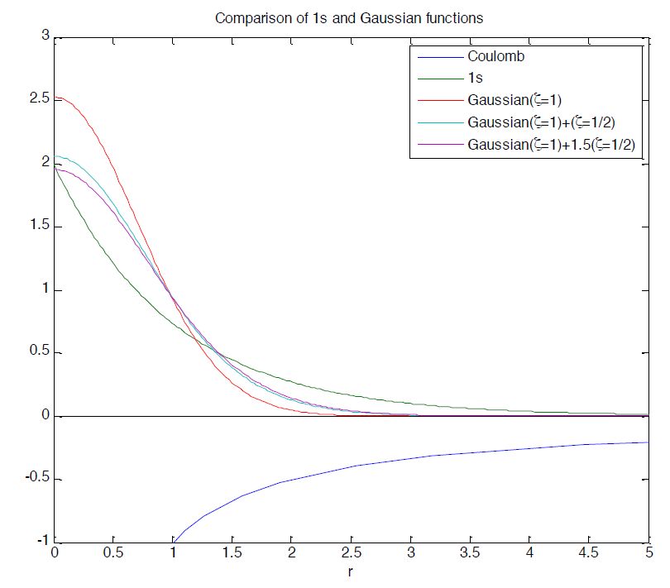

Slide 24
Atomic orbital basis sets common, can be analytical functions, numerical, Slater, Gaussian, etc…

Slide 25
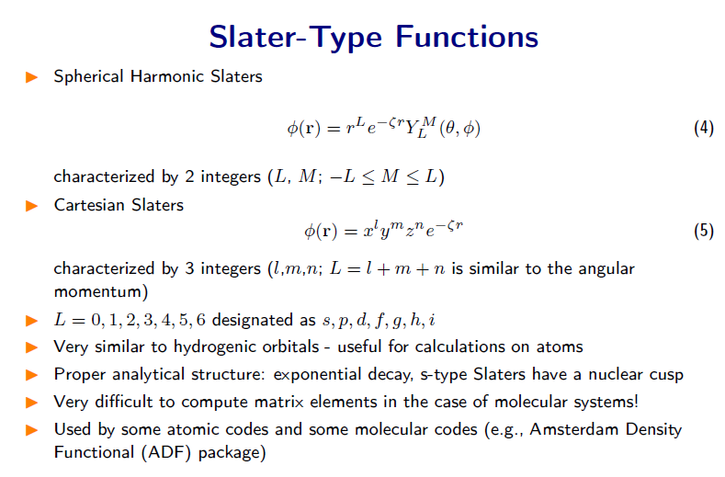
Slater-type orbitals have an exponential term that is more hydrogen like, but are computationally longer to evaluate integrals than Gaussians

Slide 26
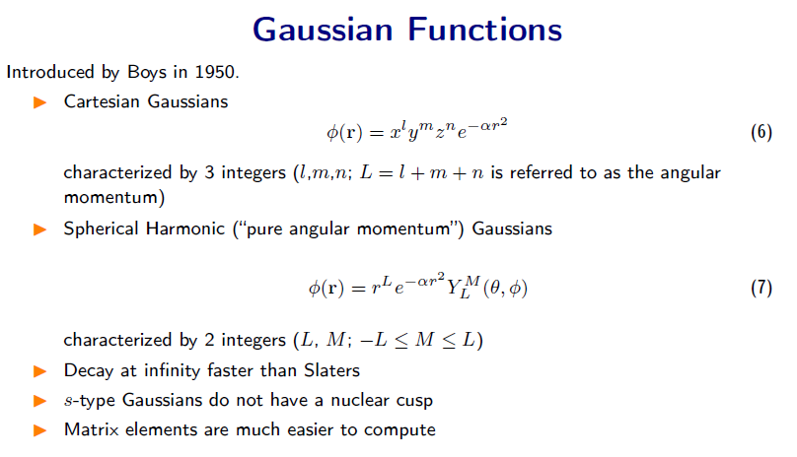
Gaussians are quicker for a computer to evaluate in integrals, but don’t physically look like H-like so need to add more of them together….

Slide 27
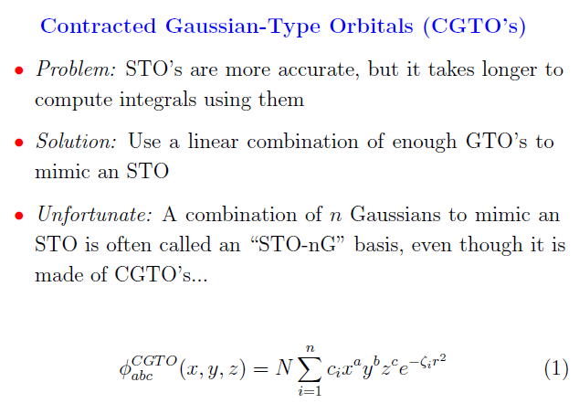

Slide 28
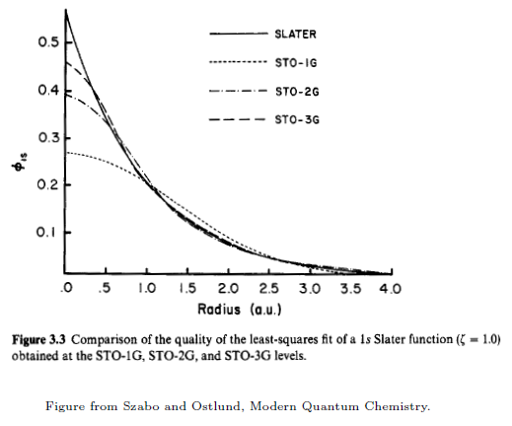

Slide 29
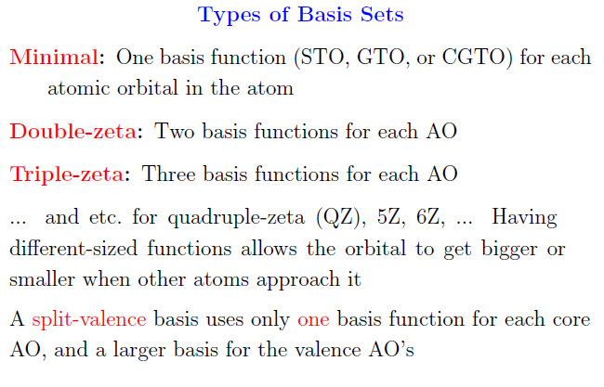
We can give a C atom one set of 1s, 2s, and 2p orbitals, OR why not give it 2 of them with slightly different decay rates, shapes……

Slide 30
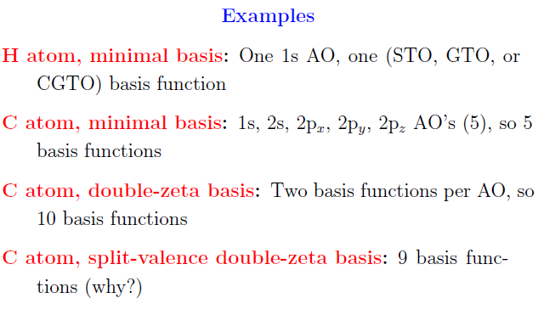

Slide 31
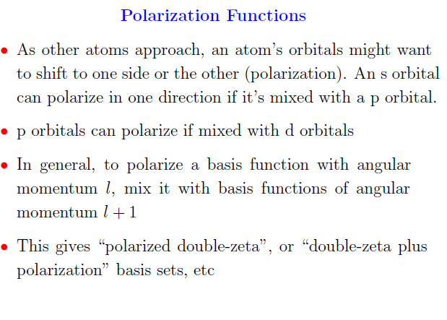
Polarization functions – why not give H some p-orbitals in basis, C some d’s? (p orbital in H-H direction of H₂⁺ very helpful in getting more accurate orbital and molecule energy)

Slide 32
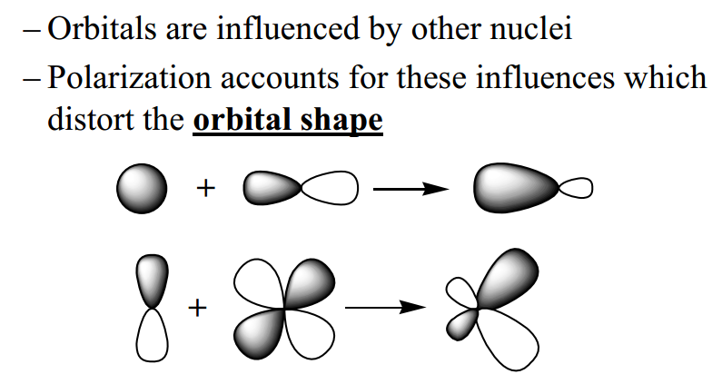
Polarization Functions – Orbital Mixing

Slide 33
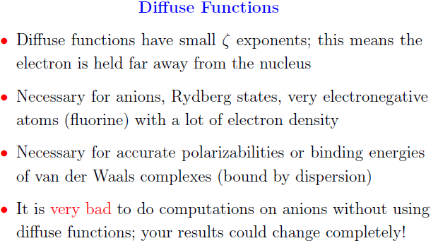
Diffuse functions - Sometimes electrons reside further from nuclei than captured with a typical basis set, especially for ANIONS

Slide 34
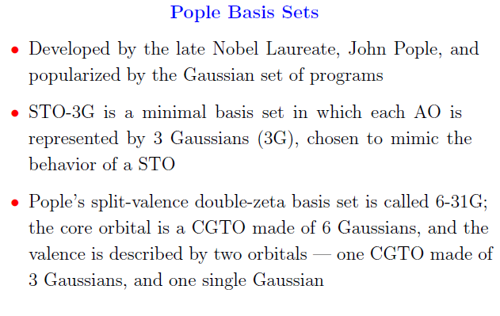

Slide 35
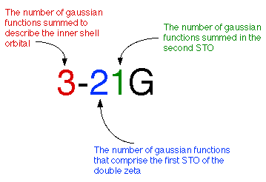

Slide 36
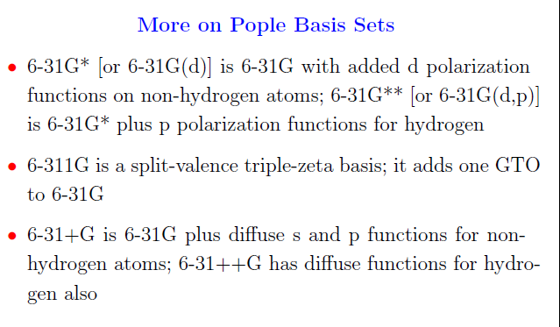

Slide 37
Key points from basis sets
Basis set can effect results – is an important choice to make when performing quantum chemistry calculations
Basis set choice is dependent on chemical intuition, computational time constraints, and should consider established norms
For accuracy bigger basis set is better – add polarization, diffuse, more zetas. If they are unnecessary, their coefficients in LCAO will end up being 0….
The notation used is not intuitive – need to look up what it means (6-++31g+*p……)
6-31 higher numbers mean more basis functions per orbital
* - polarization function, adds d to sp-block atoms
** - polarization, but also adds p to hydrogen
+ adds diffuse functions s and p functions
++ includes diffuse functions for hydrogen also

Slide 38
Our H₂⁺ example was too easy because we didn’t have to worry about e⁻-e⁻ interaction. When we have interacting electrons, constructing the terms inside the “secular matrix” becomes more complicated
So we have to go back to more DFT theory to get there…..

Slide 39
Structure of a DFT calculation is still similar, minimize E with respect to n(r) instead of ψ(r)
Minimize the energy functional with respect to n(r)
How should we do this?
Capelle, Brazilian Journal of Physics, 36, 1318-1343, 2006
neerajrai@che.msstate.edu

Slide 40


Kohn-Sham approach – we don’t know how to write KE(n), so re-invoke (non-interacting) e’s and lump what we get wrong into E_{XC}
Write down total kinetic energy functional as sum of non-interacting particle density (n) and the one that represents rest of the kinetic energy functional
where,
We rewrite the exact energy functional as:
Capelle, Brazilian Journal of Physics, 36, 1318-1343, 2006
neerajrai@che.msstate.edu

Slide 41

Exchange-correlation functional – hardest part to internalize
Exchange correlation functional is decomposed at exchange functional and correlation functional
There is no “classical physical” way for us to “visualize” or explain what these are – all attempts will feel approximate
Exchange – extra repulsion beyond density-based Coulomb’s law associated with the energy penalty of putting two electrons in the same orbital with the same spin
Correlation – electrons will lower their energy by “correlating” their motion to avoid each other.
DFT – we collectively lump these two (and what we got wrong in the KE when we made a non-interacting picture, and what we get wrong letting electrons interact with themselves in Hartree term) into a functional that captures everything we aren’t sure how to get right…..
neerajrai@che.msstate.edu

Slide 42



Kohn-Sham approach
determine orbitals for the Schrodinger equations:
where,
density is determined from these orbitals
Capelle, Brazilian Journal of Physics, 36, 1318-1343, 2006
neerajrai@che.msstate.edu

Slide 43




Approach – variationally solve K-S eqns, with a “SCF” approach
nuclei-nuclei
Coulombic
electron kinetic energy
electron nuclei
Coulomb
electron electron
“average” Coulomb
electron exchange
+correlation
V_{H}, V_{XC} depend on n(r), but n(r) depends on set of ψ_{i}’s – self-consistent field procedure:
Use “old” coefficients in the ψ_{i}’s (old c_{i}’s) to get n_{old}
Construct “Hamiltonian” and solve for new ψ_{i}’s. Calculate new n
Check if E(n_{new}) = E(n_{old}) and if not, use a convergence procedure (choose alg.) and keep trying

Slide 44
General scheme of an ab initio geometry optimization calculation
Born Oppenheimer approximation – nuclei heavier and slower than electrons, so we can think of nuclei as static “atom position”, electrons adjust, and potential energy surface is the energy of the system as a function of nuclei positions, with electrons in “optimal” configuration at each set of nuclei position
Build structure – guess of nuclei positions (ie, where are the nuclei)
“guess” wavefunctions (ie, where are the electrons)
iterate on wavefunctions until wavefunction_{new}=wavefunction_{old}
(converged, “self consistent field”)
determine forces on atoms
check if forces, energy change
meets convergence criteria
Energy
Diatomic molecule distance

Slide 45
Why quantum mechanics? What properties can we calculate with quantum mechanics?
Properties we can’t get from anything other than QM:
Properties we might get more accurately or quickly with QM compared to FF methods:

Slide 46
Why quantum mechanics? What properties can we calculate with quantum mechanics?
Properties we can’t get from anything other than QM:
Electron excitation energies
NMR shifts
Work function of a solid/surface
Electrostatic potential distribution about a molecule/surface
Electron conductivity (rates of electron motion)
Properties we might get more accurately or quickly with QM compared to FF methods:
Structures, especially of small systems (molecules, crystals)
Reaction energies (cohesive energies, thermodynamics)
Activation barriers (rates of chemical transformation)
Vibrational frequencies

